Slide 1








Activities in Task 14.3.1
Test infrastructure for innovative calorimeters with semiconductor readout
Vincent Boudry
École polytechnique, Palaiseau
on behalf of the WP14.3.1 task participants
AIDA-2020 WP14 Face2Face meeting
27/01/2016

Slide 2
Task 14.3 Test infrastructure for innovative calorimeters with semiconductor readout
(CERN, CNRS-LAL, CNRS- LLR, CNRS-LPNHE, DESY, TAU, AGH-UST)
Assembly and QA chain for silicon-based Ecals
  Development of an assembly line for highly granular calorimeters with semiconductor readout
  Test benches for individual silicon wafers and PCB for quality assurance and to study alternatives
  Development of a test station to determine signal characteristics in highly irradiated silicon sensors
  Validation of a compact calorimeter prototype including flexible precision mechanics and readout
Calorimeters with pixelated Si wafers allow for an excellent particle separation. After an extensive R&D activity supported by EUDET and AIDA, the next step is the development of tools for construction and quality assurance of large-scale prototypes for an ILC-like detector. This starts with the production of test benches for Si wafers and interface boards. These components are glued together into a detection unit of the order of 20×20 cm² using a robotic system. Up to 10 units will be assembled into detector layers using automated tools.
Such a calorimeter could be also a viable option in a hadron collider environment, such as CMS. A dedicated test set-up is needed to test the signal characteristics of irradiated Si wafers operated at temperature at or below -35 degrees C.

Slide 3



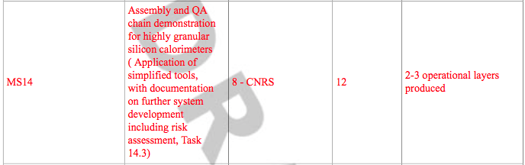
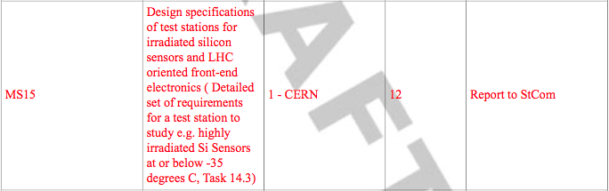
MS & D

Slide 4
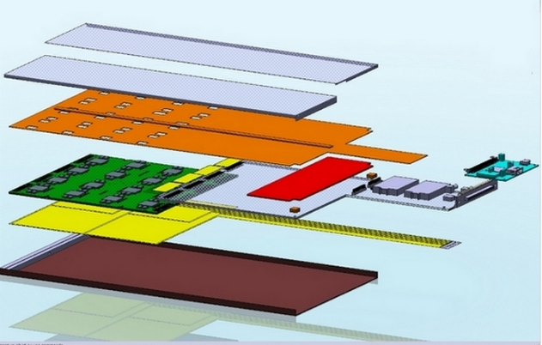
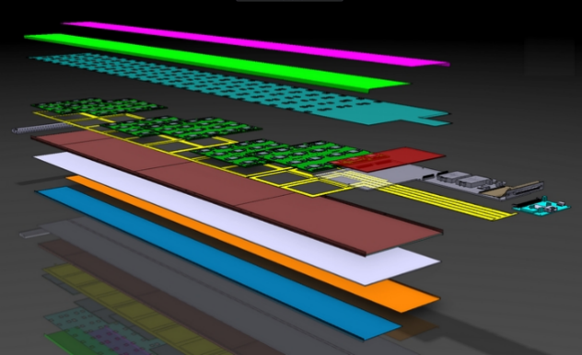
SLAB Assembly: full chain
Copper (cooling)
Shielding
PCB
(FeV)
R&D for “mass production” and QA
  Quality tests & preparation of large production
  Modularity → ASU & SLABs
    Choice of square wafers
    (≠ from hex: SiD, CMS HGCAL)
Numbers (R_{ECAL} = 1,8 m, |Z_{Endcaps}|=2,35m)
(likely to be reduced by 30–40%)
  Barrel modules: 40 (as of today all identical)
  Endcap Modules: 24 (3 types)
  Slabs = 6000 (B) + 3600 (EC) = 9600
    many ≠ lengths
  ASUs = ~75,000
    Wafers ~ 300,000 (2500 m²)
    VFE chips ~ 1,200,000
    Channels: 77Mch
ASU
Wafer (4)
Adapter board
(SMB)
Carbon+W
U layout of a short slab
U layout of a long slab

Slide 5
Plans for CALICE/ILC
Plans from may 2015
Deliver test benches for a limited production of Detector Assemby Units (ASU)
  Pre-automatic benches being designed
    LPNHE ↔ LLR ↔ LAL work flow
  Procedure, validation, semi-automatisation
  part of AIDA-2020-WP14.3.1
Production:
  2015: 1st batch of ~6–8 ASU’s
    for testing of procedure, debugging,
    test beam (with CMS ?)
    → gain of knowledge on building
    → 6-7 short slabs + 1 “naked” long SLAB
  2016: 2nd batch of 12+ ASU
    with semi-automated procedure ?
    ≠ type of wafers (edgeless, 700μm), …
    1 SiW Stack + 1 long SLAB
November 2015
7 produced (PCB with glued wafers),
5 tested, 2 still to be tested
3 in beam tests
prelim BT results...
⇒ Now being assembled in SLAB’s
Jan 2016 : :
7 to be assembled in SLAB’s (wrapping)
6 others to be produced ≤ August

Slide 6
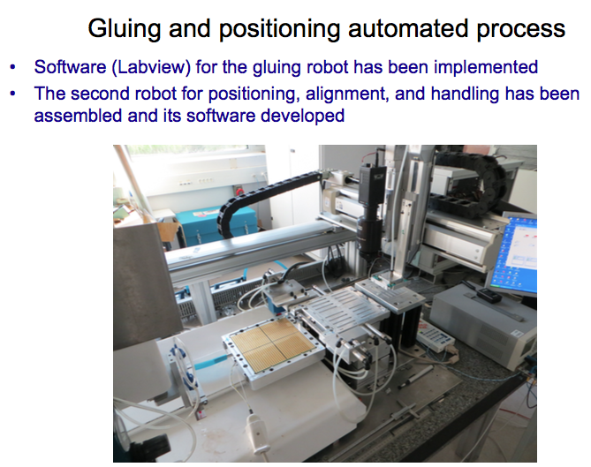
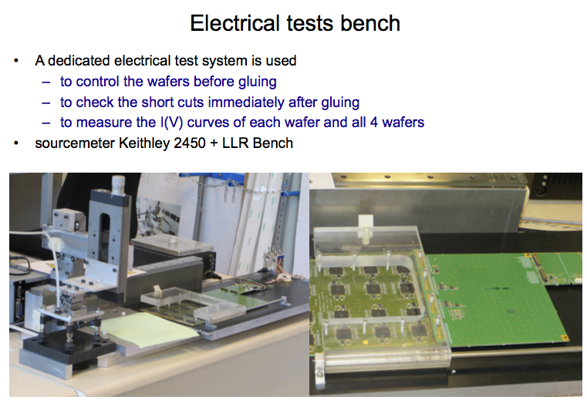
Measurement and Gluing Test Bench (LPNHE)
Several test with fake (glass ASU)
7 real (Silicon) ASU glued and being tested.
  4 in beam,2 with “edgless wafers” (HPK)
  Quality procedure to be consolidated

Slide 7
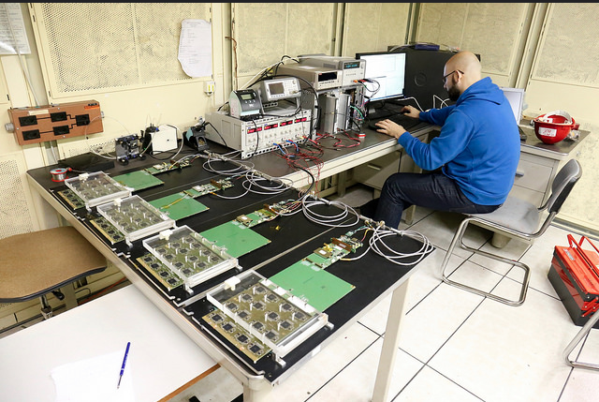
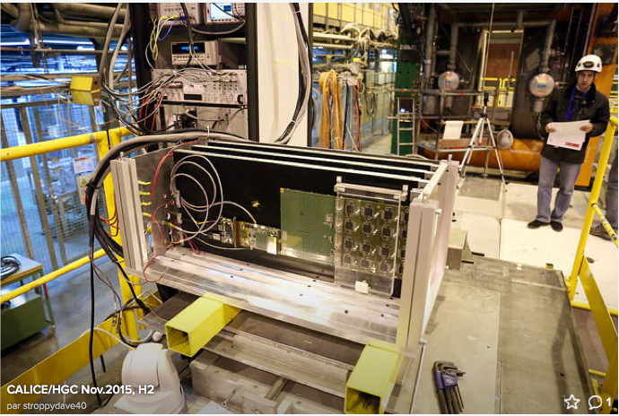
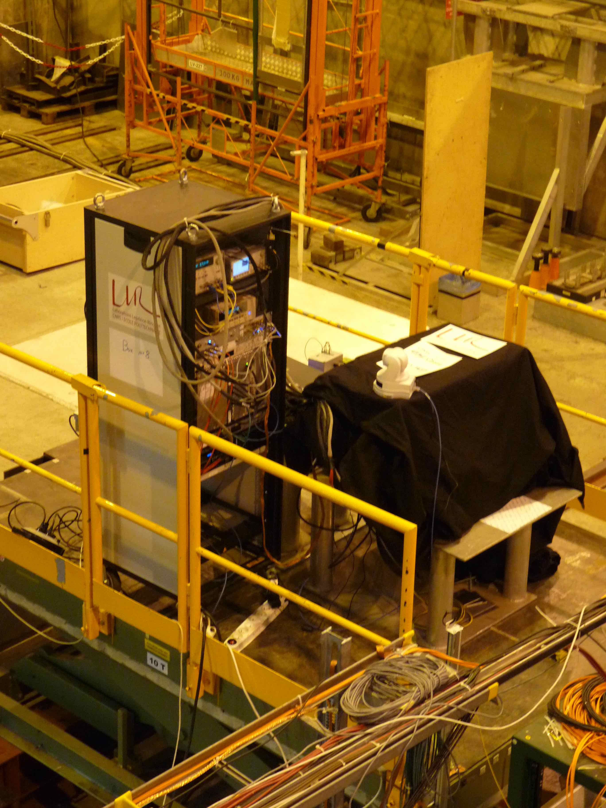
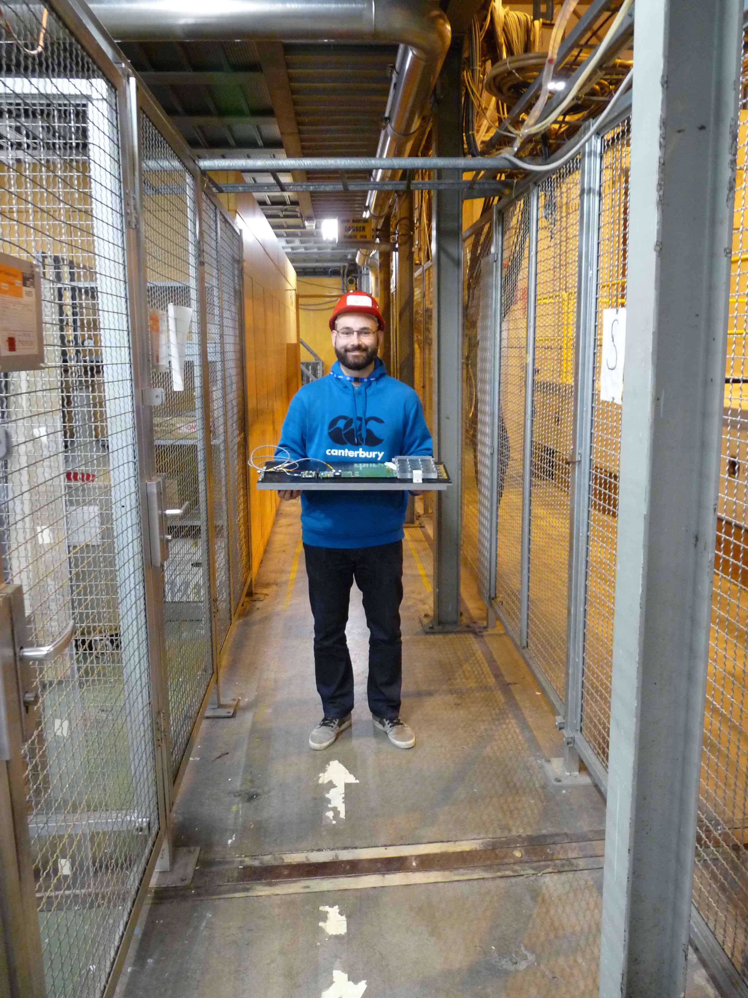
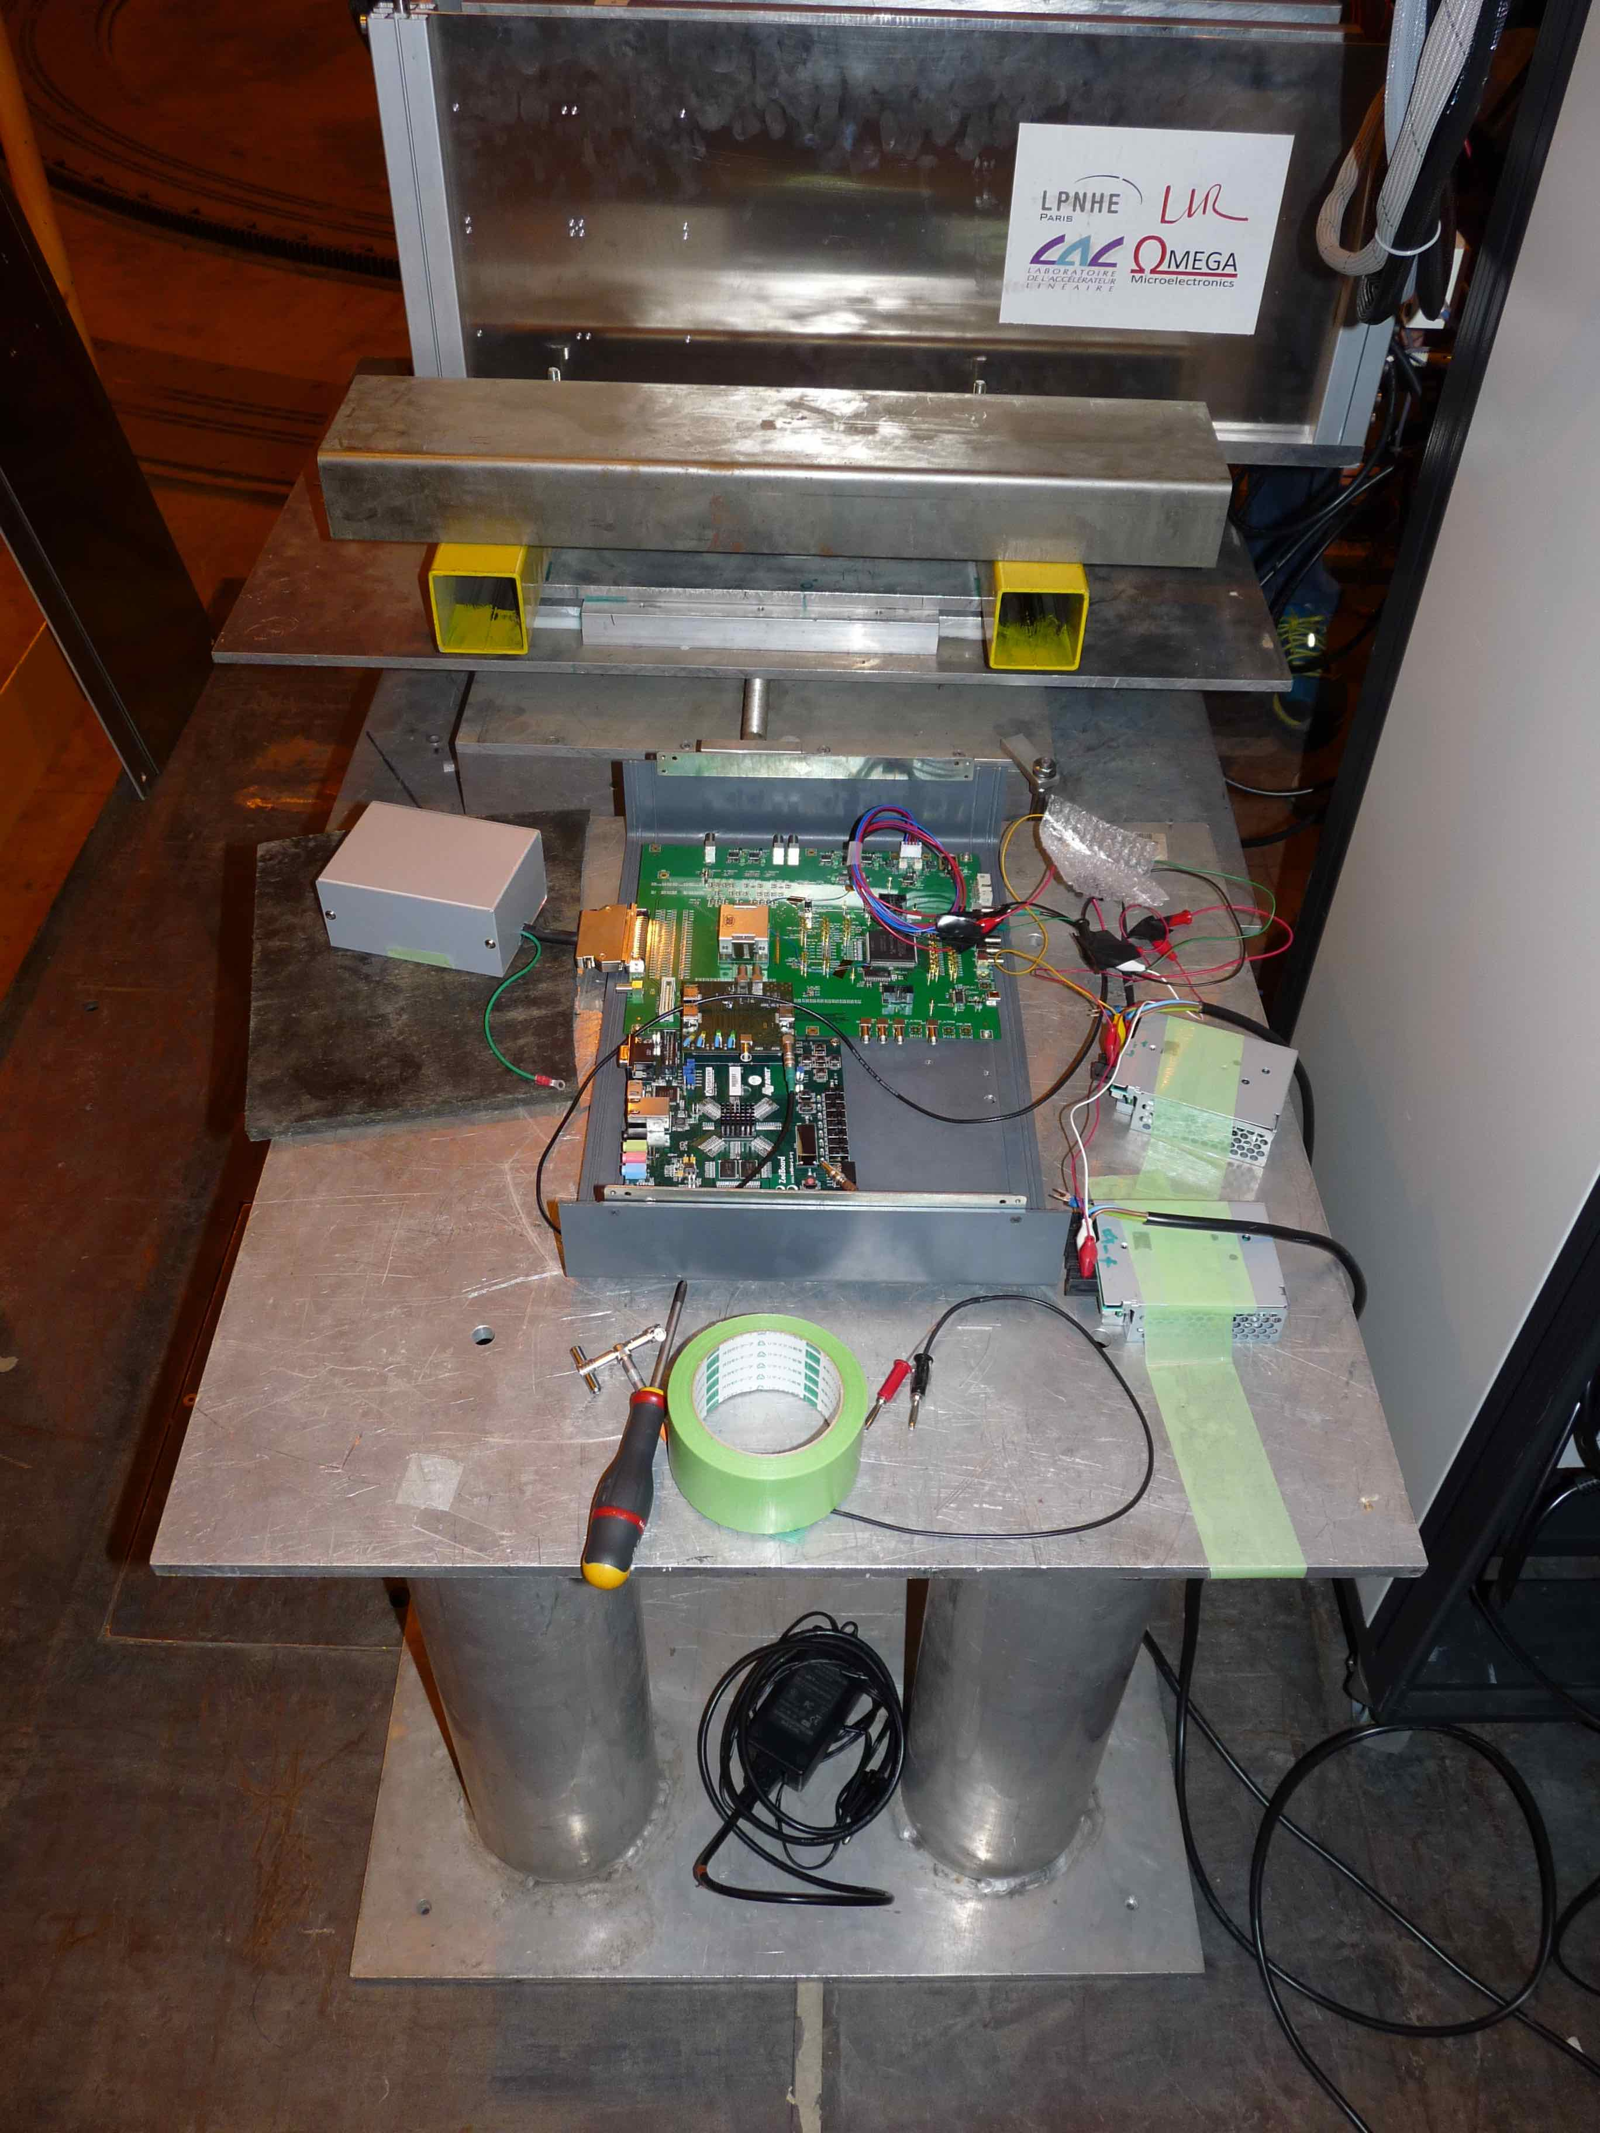
Beam tests (2–16th of november)
Very smooth installation & running thanks to CMS support

Slide 8
Beam test CALICE-CMS
For AIDA-2020: test “more extensive” than expected for bare ASU’s
  Main Goal: test chips in HE showers(electrons, hadrons)
1st Prelim results:
  now focused on the remaining defaults from SKIROC2 in view of production…
    Main retriggers; already MUCH better (no more “plain events” filling memory) than previous implementation; hints on process for plain events sighted…
  Square events seen…
  MUCH MUCH still to be done…
Next beam tests with SDHCAL ;June too early for full production, 7 SLAB’s “only” ?
  Not with the EUDET structure (SLAB’s+Tungsten) too thick for the structure
  Flexible structure to be designed and built.

Slide 9
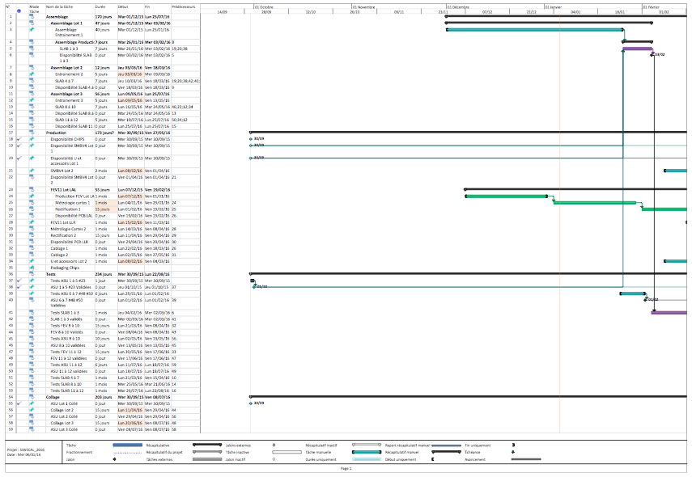
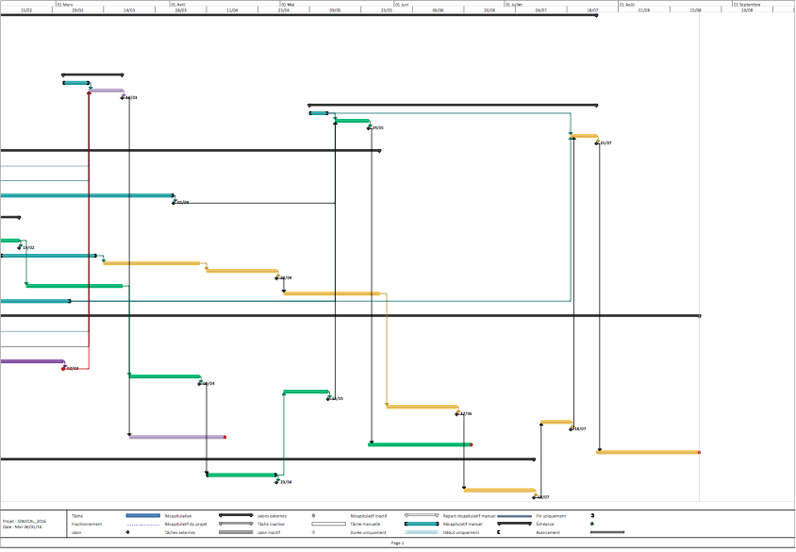
Production of SLAB’s
Plan now rather precise (but still moving under administrative constrains)
  Prod between LLR + LPNHE + LAL
  Supervision done by Rémi Cornat → production for next TB
  ~3 batches of production
    All critical material available (ASIC’s, Wafers)
~Now
August

Slide 10
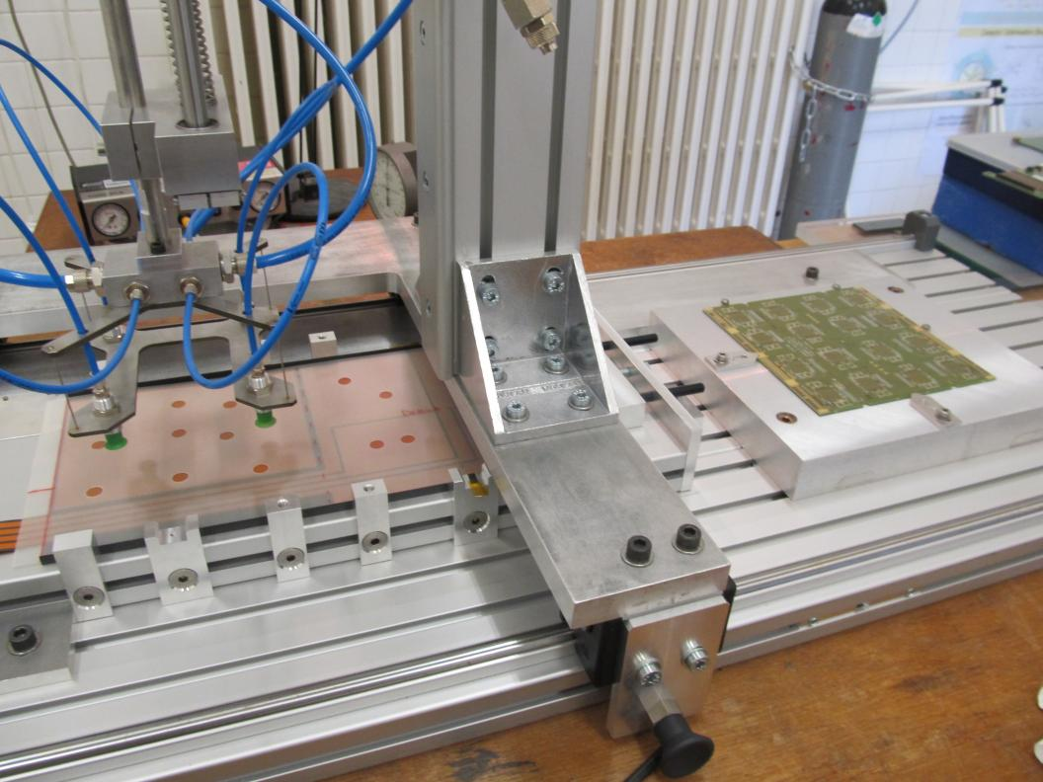
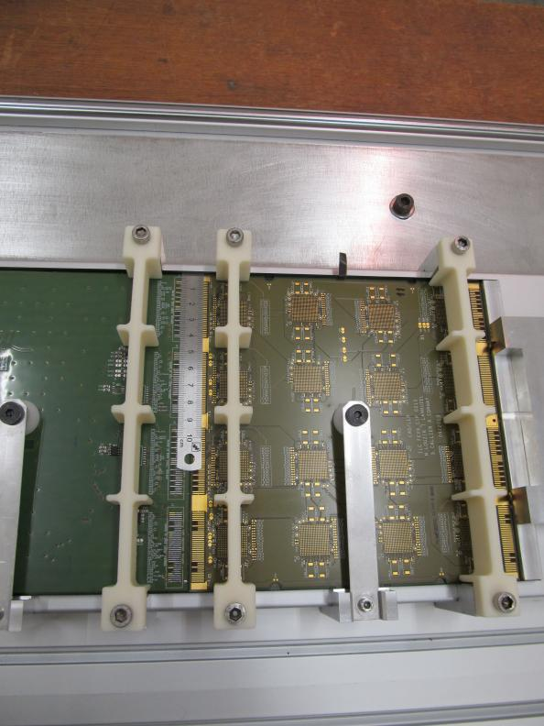
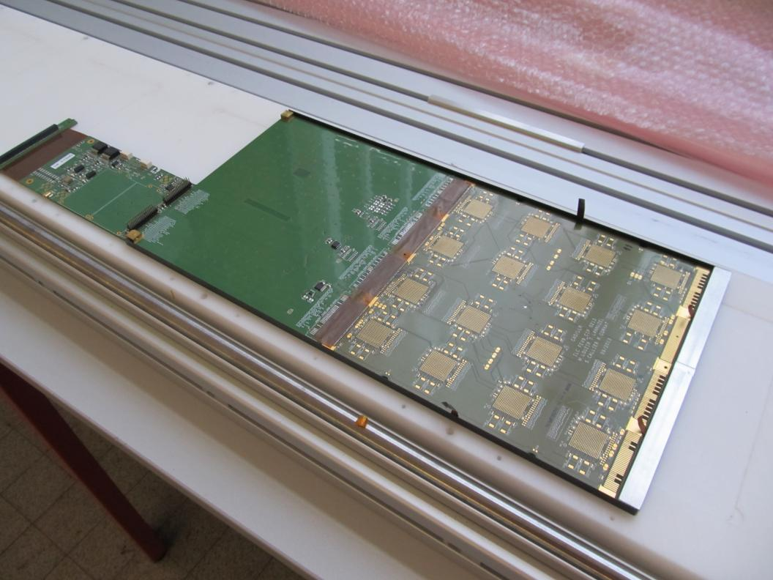
Assembly (LAL)
Pick and place
Precise alignment
Ready for test
Assembly steps are almost validated with short layers (within days)
  3 mock-up SLAB produced (using fake wafer’s)
  real short SLAB’s to be soon processed
Need big step towards long layer to assure high quality product
  Automated pick-and-place and alignment
  Interplay of many different working steps, e.g.
    a) Assembly proper
    b) Continuous control of up to 10 ASUs during assembly
Successful product requires a lot of testing and exercising of well trained technical staff!!!
R. Poeschl

Slide 11
CMS-HGCAL Irradiation tests
MS15:
  "Design specifications of test stations for irradiated silicon sensors and LHC oriented front-end electronics ( Detailed set of requirementsfor a test station to study e.g. highly irradiated Si Sensors at or below -35 °C, Task 14.3)"
    Marcello Mannelli: the test set for irradiated sensors is well advanced: a climate chamber able to go down to -60 °C has been purchased and commissioned, together with a first set of low noise read-out electronics and a radio-active source and trigger, to enable detailed measurements of single MIP response of highly irradiated sensors
Related but... not the same (some confusion occurred in the past):
  Plans building for irradiation test of Carbon-fibre samples at JSI (TRIGA Reactor, Slovenia using TNA): Ch. Ochando, M. Frotin (LLR)
Not related but… almost the same:
  Plans for irradiation of glued Si samples for ATLAS-HGTD at JSI (TRIGA Reactor, Slovenia using TNA): D Lacour, see next presentation

Slide 12
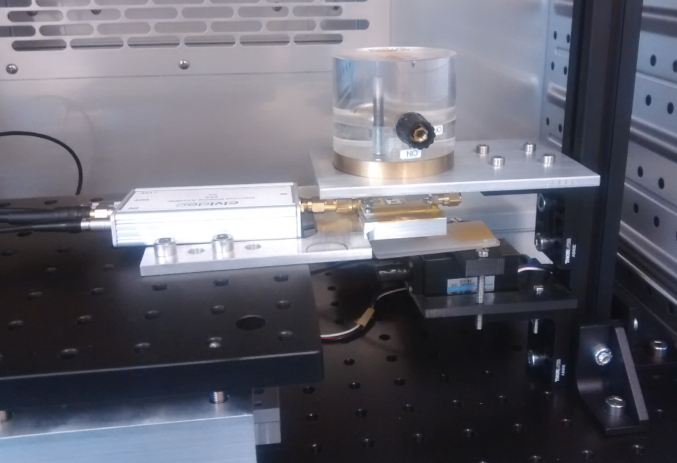
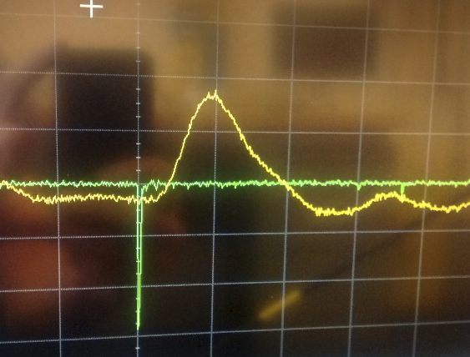
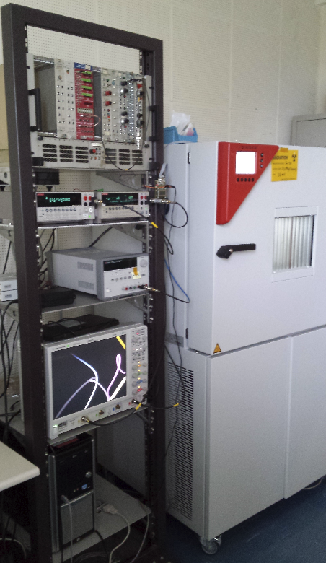
MIP sensitivity setup SSD at CERN
PT1000: show us the real temperature of the pcb
Sensor (FZ120P) mounted on a pcb
RS, sr 90
collimator
Charge amplifier
Photomultiplier
XY stages --> allow the external positioning of the sensors inside the beam
Example of one single signal given by the charge amplifier in yellow. The amplitude of this signal is proportional to the charge collected from the sensor after one MIP.
Set-up inside a climatic chamber:
  Operation temperature between -70°C and 180°C
  Humidity below 10% RH
Fom M. Moll, E. Curras Rivera

Slide 13
Summary
Milestones:
  MS14: 2-3 SiW-ECAL operational layers ~ reached.
  MS15: over-reached! (realisation rather than design).
    to be documented…

Slide 14
Not in AIDA-2020 but for completion...
ASIC’s production (OMEGA)
Launch of a production of SKIROC2CMS (these days, if not yet done…)
Reception in April...
  Pin2Pin Compatible with SKIROC2 ⇒ Test on CALICE boards ?
  Time Over Threshold measurement
  Faster shaper (20ns), many samples for 1 pulse (40 MHz), memory roll mode
  TDC (goal ~1/20 ns precision)
Launch of a production of SKIROC2A with “light” improvements:
  Substrate isolation; delay box; ‘0 hit’ events; enlaring of thr. adjustment; ...

Slide 15
Extra

Slide 16
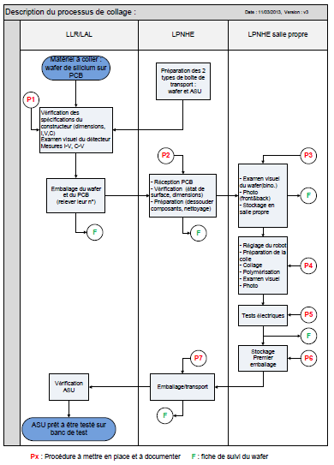
Quality insurance
Task flow has been completed
Reception and gluing procedures for 1 and 4 silicon sensors are written
each operation on PCB is monitored (follow up)
Each gluing test is registered

Slide 17

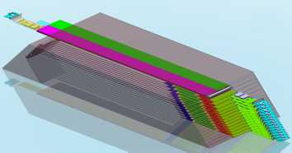
SiW ECAL: Physics & Technological prototype
Physics prototype: 2005-2011
Technological prototype
PFA proof of concept with comparison to MC
(PandoraPFA etc.)
Electronics outside
  1cm x 1cm pixels
  full 30 layers
(used for PAMELA sat.)
16.5%(stochastic) 1–2% (constant) obtained
with 1–45 GeV e⁻/e⁺ at 2006/2008 BT
Embedded electronics
  SKIROC2 analog/digital ASICs
    auto-triggered, zero suppr., PP
  pixels 5×5mm²
Assess the feasibility:
Establish procedures and develop
test benches for mass production : AIDA-2020, pre-prod test benches.
  10 000 SLAB’s ⊃ ~75 000 ASU to be produced for ILD

